Slide 1
RealEstate Web Application
Developed by Benimana Josue
Angular (Frontend) + Symfony (Backend)

Slide 2
Project Description
A real estate platform that connects buyers, sellers, and renters.
Users can:
- Browse properties by location, price, and type
- Save favorite properties
- Manage their search preferences
- Contact property owners directly

Slide 3
Technologies Used
Frontend: Angular
Backend: Symfony (PHP)
Database: MySQL
API: RESTful architecture
Other Tools: TypeScript, Doctrine ORM

Slide 4
Angular Models
Property {
id, title, description, location, price, type, propertyType,
bedrooms, bathrooms, area, images, contactPhone, contactEmail, createdAt
}
User {
id, name, email, roles[], savedProperties[], searchPreferences
}

Slide 5
Symfony Backend
- Follows MVC architecture
- Exposes RESTful API endpoints:
/api/properties
/api/users
/api/search
- Handles authentication and data persistence

Slide 6
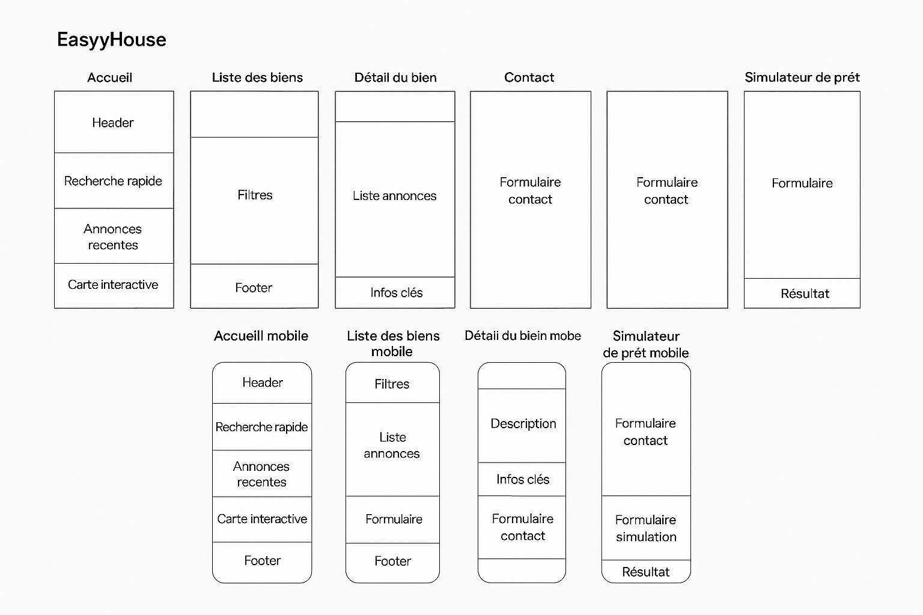
Figma UI Design (Desktop + Mobile Layouts)
Modern blue & white interface showing filters and property cards.

Slide 7
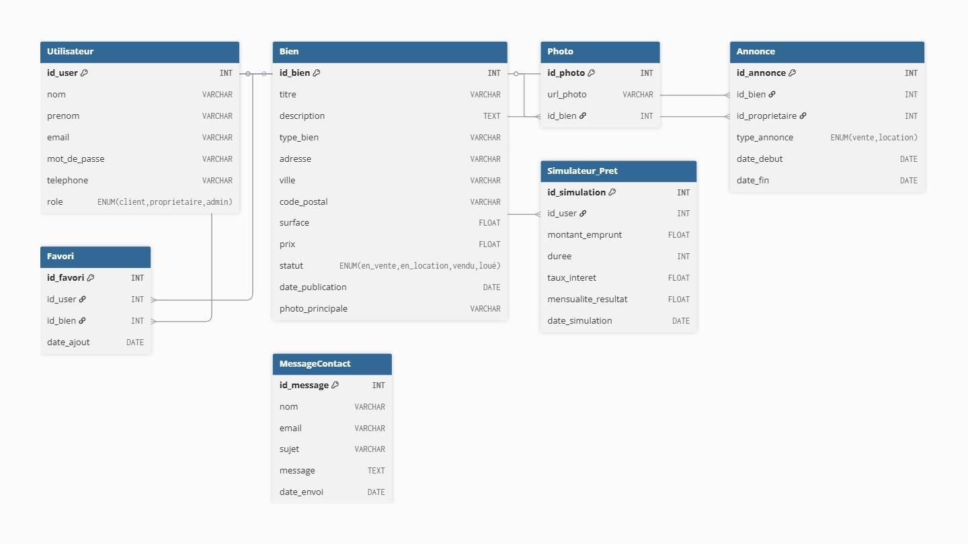
MCD Diagram
Entities: User, Property, SearchPreferences with their relationships.

Slide 8
Features
- Property browsing and filtering
- Save favorite properties
- Contact property owners
- User authentication & roles
- Personalized search preferences

Slide 9
Conclusion
A full-stack real estate web app demonstrating:
- Integration of Angular + Symfony + REST API
- Scalable and modular architecture
- Clean UI and robust backend

